Slide 1
Etraveli Group Case Study Analysis

Slide 2
Overview of the Analysis
This analysis explores customer service interactions using two datasets:
Errands Dataset: Detailed records of customer interactions, including reasons for contact, communication channels, and actions taken by agents.
Orders Dataset: Comprehensive booking and order details, including travel routes, customer demographics, and purchase history.
Objective
To identify patterns and trends in customer service interactions, providing actionable insights to enhance operational efficiency and improve customer satisfaction.
Key Focus Areas
Customer Contact Behavior:
Distribution of the number of contacts per order.
Average customer interactions per order.
Service Channel Analysis:
Communication preferences and trends (e.g., chat, phone, email).
Efficiency of customer service channels.
Order Characteristics:
Correlation between order attributes and customer service interactions attirbutes.
Actionable Insights:
Recommendations to reduce contact frequency and optimize service processes.

Slide 3
Customer Contact Efficiency Analysis
Average Contacts per Order
The average number of contacts per order is 2.81.
This indicates that on average, customers need to contact customer service nearly 3 times per order. This could highlight potential inefficiencies or areas for improvement in resolving issues during the first interaction.
Focus on improving FCR rates to bring down the average contacts per order from 2.81 to a lower value.

Slide 4
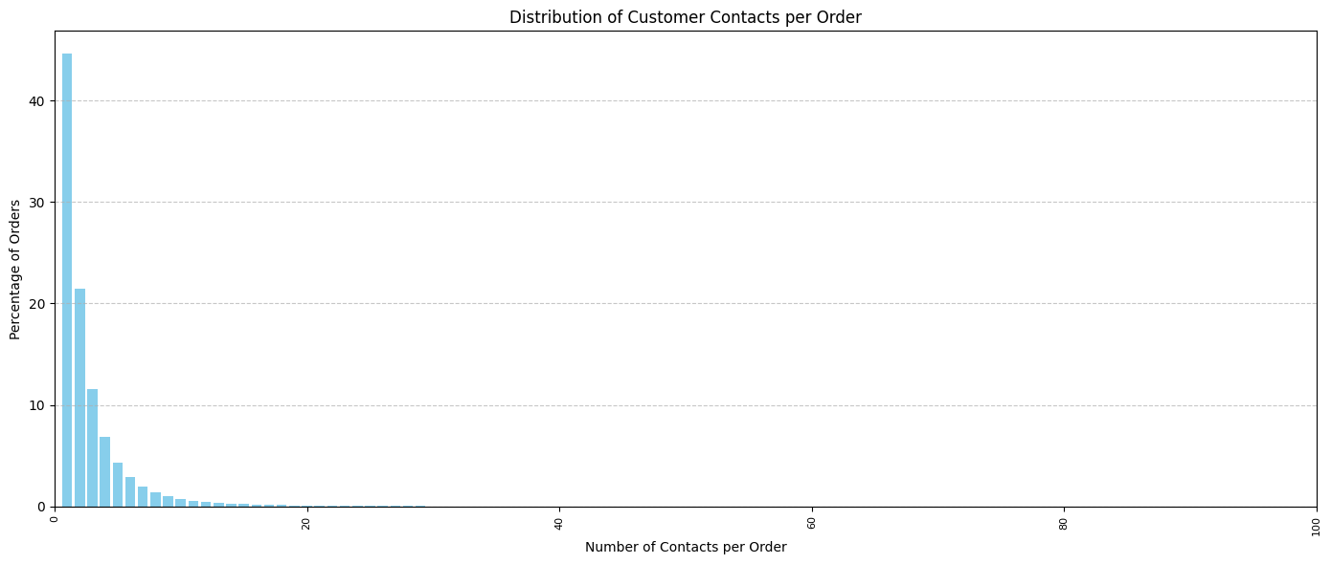
Distribution of Customer Contacts
1. 45% of orders require only 1 contact:
This is a positive insight, showing that nearly half of the orders are resolved with a single interaction, reflecting efficiency in handling
simple customer inquiries or issues.
2. 22% of orders require 2 contacts:
A significant percentage of orders require follow-up interactions, which might indicate the need for better first-contact resolution
for moderately complex issues.
3. 12% of orders require 3 contacts, and smaller percentages (7%, 4%, etc.) involve 4 or more contacts:
While most orders involve fewer interactions, there is a considerable percentage of orders where customers must contact multiple times,
potentially leading to customer dissatisfaction.

Slide 5
High-Contact Orders (7+ Contacts)
Orders requiring 7 or more contacts account for 8% of all orders (cumulative):
These are outliers that could indicate complex or unresolved issues, requiring escalation or repeated follow-ups.
Investigating these high-contact cases can provide insights into recurring issues or inefficiencies in the resolution process.
Rare Scenarios (11+ Contacts)
Orders requiring 11 or more contacts are very rare (1% or less):
This is a small but critical category to analyze further, as such cases might indicate severe bottlenecks in customer service or extremely complex order issues.
Room for Improvement
Over 55% of orders require more than 1 contact:
While many orders are resolved quickly, there is room to improve resolution rates on the first contact, particularly for issues that currently require 2-3 interactions.
This could be addressed through better training for agents, improved FAQs/self-service options, or streamlining processes for common issues.

Slide 6
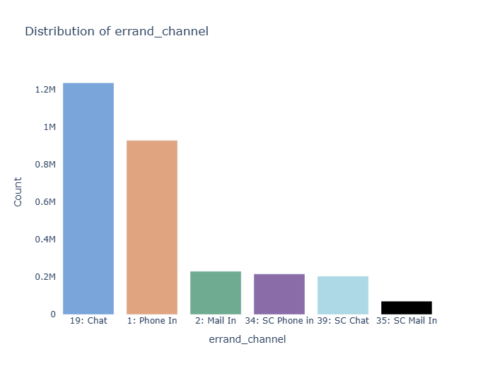
Errand Channel Distribution
Chat Dominates: The most preferred channel with ~1.2 million interactions, highlighting customer preference for quick, asynchronous communication.
Phone In Usage: Second most popular channel (~0.9 million interactions), showing customer reliance on real-time support.
Lower Mail Usage: Channels like Mail In and SC Mail In are less utilized, indicating a shift away from slower communication methods.
Specialized Channels: SC-specific channels (e.g., SC Chat, SC Phone In) have low usage, likely catering to niche queries.
Optimization Opportunities:
1. Enhance chatbots for Chat to improve efficiency.
2. Streamline Phone In services to reduce wait times.
3. Reassess the need for underutilized channels like Mail In.

Slide 7
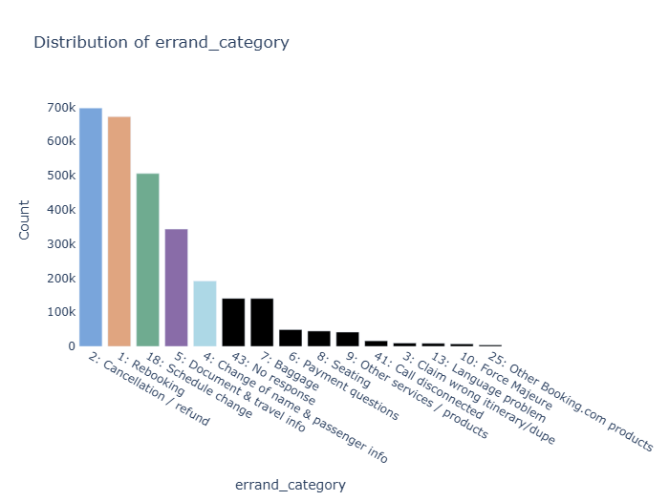
Errand Category Distribution
1. Cancellation/Refund and Rebooking dominate, each with ~700,000 interactions, indicating common customer service requests.
2. Schedule Change and Document & Travel Info are also significant contributors, highlighting frequent travel itinerary adjustments.
3. Categories like Change of Name & Passenger Info, Payment Questions, and Baggage show consistent but lower interaction volumes.
4. Niche categories such as Force Majeure and Other Services have minimal interactions, likely addressing rare issues.
5. Optimization Opportunities:
1. Focus on automating high-frequency categories like
Cancellation/Refund and Rebooking.
2. Notify customers in advance about schedule changes or payment
issues via email/SMS.
3. Deploy AI-driven chatbots to handle repetitive queries quickly,
reducing agent workload.
.

Slide 8
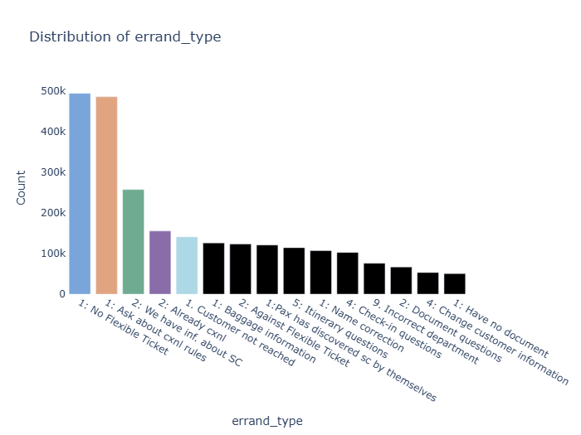
Errand Type Distribution
1. Top Errand Types:
"No Flexible Ticket" and "Ask about cancellation rules" dominate, collectively accounting for a significant portion of customer interactions.
These indicate common pain points related to ticket flexibility and cancellation policies.
2. Moderate-Frequency Types:
Types like "We have information about schedule change (SC)" and "Already cancelled" highlight frequent inquiries around schedule changes and cancellations.
3. Low-Frequency Types:
Errands like "Incorrect department", "Name correction", and "Check-in questions" occur less often but may require specialized attention.
4. Actionable Insight:
Prioritize self-service tools for high-frequency errand types.
Improve proactive communication for schedule changes and cancellation policies to reduce related contacts.

Slide 9
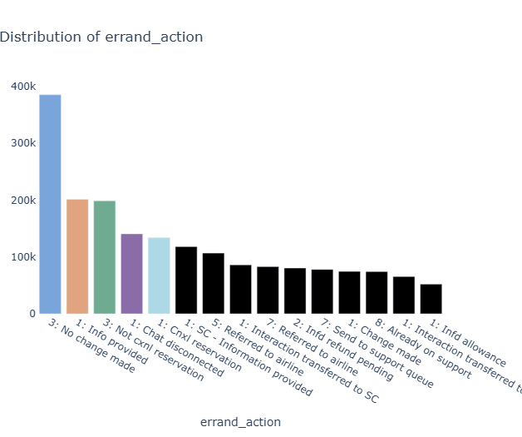
Errand Type Distribution
1. Top Errand Action:
"No change made" is the most frequent action, suggesting that many customer inquiries do not result in updates or modifications to their requests. This indicates a potential need for better self-service tools or proactive issue. resolution.
2. High-Frequency Actions:
"Info provided" and "Not canceled reservation" are significant, reflecting the demand for informational support and guidance during cancellations.
3. Moderate Actions:
Actions such as "Referred to SC (Schedule Change)" and "Interaction transferred to airline" suggest interdependencies with external systems, which might slow resolution.
4. Low-Frequency Actions:
Actions like "Refund pending" or "Interaction transferred to support queue" highlight backend inefficiencies that could be optimized for quicker resolutions.
5. Actionable Recommendations:
Introduce automated tools for handling routine tasks like cancellations and information requests.
Enhance collaboration with third-party providers to streamline actions requiring external involvement.
Improve training or processes to reduce the need for repeated or unproductive actions

Slide 10
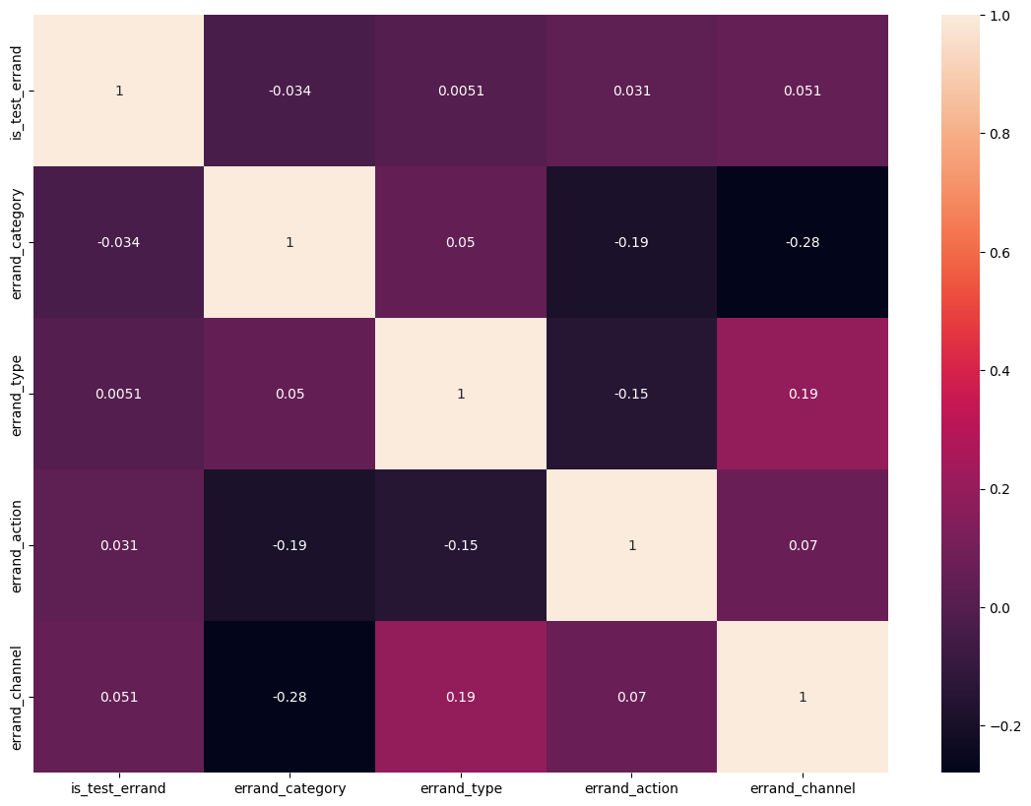
Correlation Analysis of Errands Dataset
The dataset shows weak overall correlations, suggesting that most columns contribute independent insights.
A positive correlation (0.19) between errand_type and errand_channel indicates that specific errand types might frequently use specific channels (e.g. chat, phone)
errand_channel and errand_category : A moderately negative correlation (-0.28) suggests that certain errand categories might not be strongly tied to specific channels, implying diversity in communication preferences for certain issues.
errand_category and errand_action (-0.19): Specific categories lead to consistent actions, like no changes or referrals.
Test errands (is_test_errand) show no significant influence on the other features
Actionable Recommendations:
Errand Channel Optimization: Focus on errand types strongly linked to channels to enhance efficiency (e.g., streamline chat support for certain queries).
Errand Category Review: Categories with weak correlations to channels/actions might need re-evaluation to ensure consistency in support handling.

Slide 11
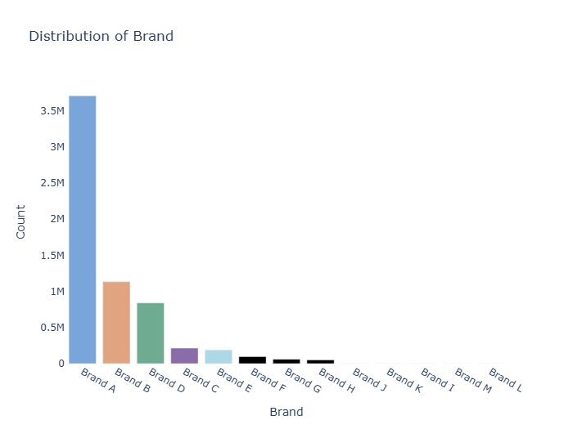
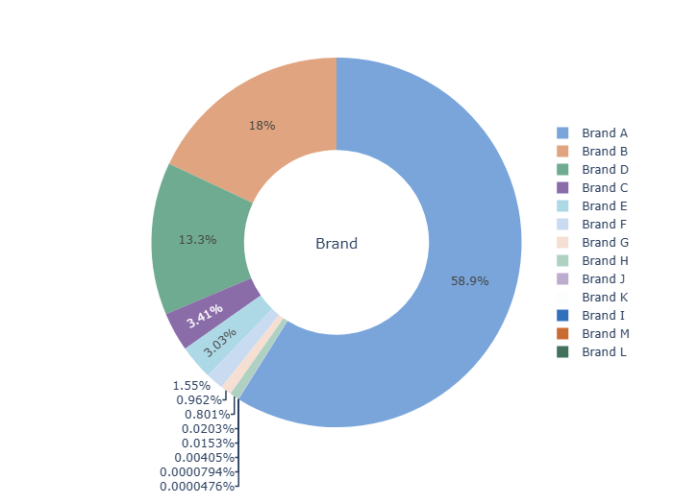
Order Brand Distribution
Brand A dominates bookings, accounting for the highest count, suggesting its widespread popularity or larger market presence.
Brand B and Brand D follow as the next most significant contributors, but their counts are considerably lower than Brand A.
Brands C, E, and beyond show minimal presence, indicating niche or limited market penetration.
The steep decline in counts after the top three brands suggests a highly skewed distribution, with most bookings concentrated among a few dominant brands.
Insights guide strategies like focusing on expanding underperforming brands or leveraging Brand A's popularity for cross-promotions.

Slide 12
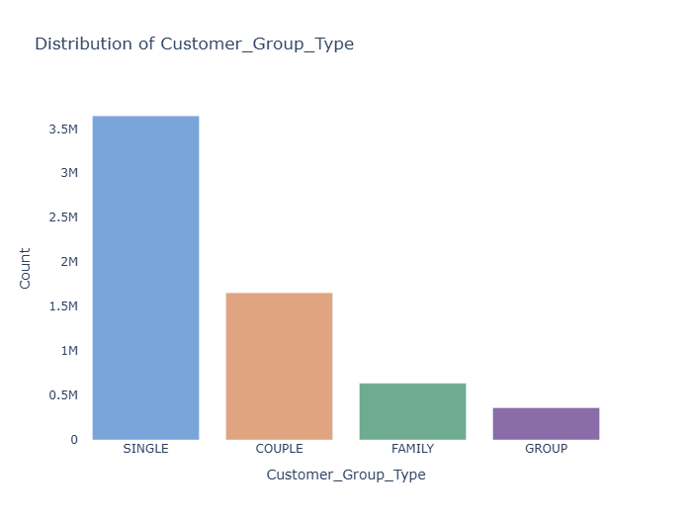
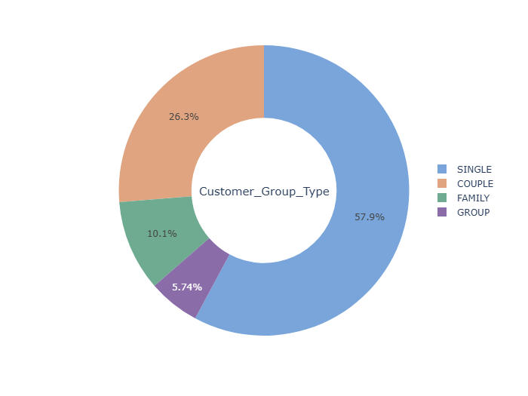
Order Customer Group Type Distribution
1. Single Customers Dominate:
Single customers account for the largest proportion of bookings, with 57.9% of the total orders. This indicates that individual travelers are the primary user base.
2. Couples Make Up a Significant Portion:
Couples represent 26.3% of the orders, highlighting a substantial demand from dual travelers.
3. Family and Group Travel Are Limited:
Family bookings account for 10.1% of orders, while group bookings constitute a smaller share at 5.74%. These figures suggest less focus or market share in these segments.
4. Potential for Growth:
The lower percentages for families and groups could indicate an opportunity to develop targeted campaigns or services to attract these segments.
These insights can guide marketing efforts and product offerings to better cater to the primary customer segments while identifying opportunities for growth in underserved areas.

Slide 13
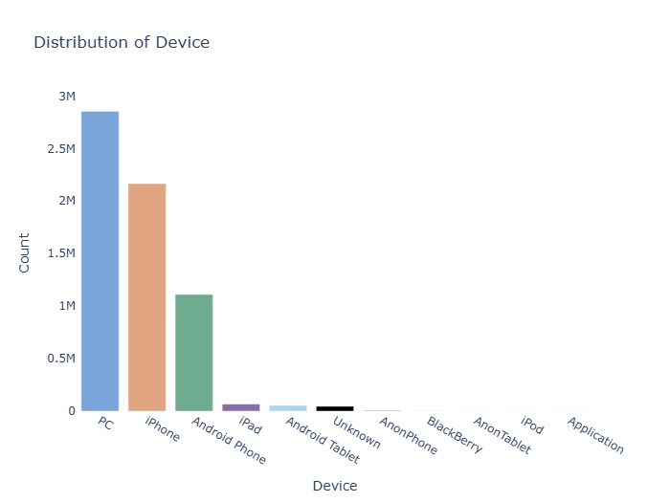
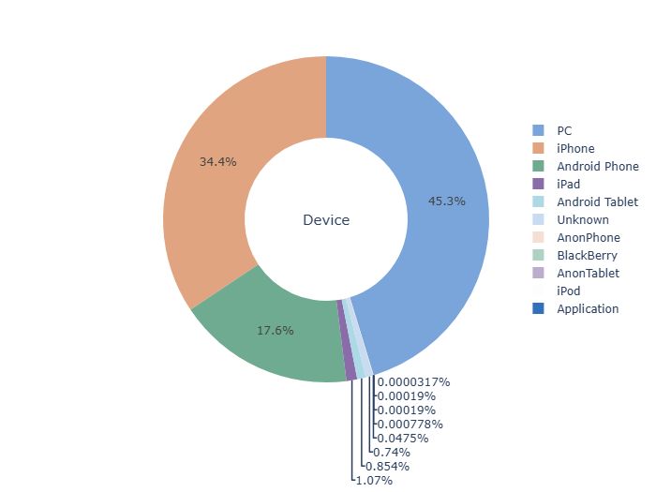
Order Device Distribution
PC Dominance: PCs account for the highest percentage of bookings at 45.3%, making them the most used device for placing orders.
iPhone Usage: iPhones represent 34.4%, highlighting their strong presence among mobile device users.
Android Phones: Android Phones contribute to 17.6% of the orders, demonstrating significant adoption among users.
Minimal Usage: Devices like iPads, Android Tablets, and other uncommon devices collectively make up less than 3%, indicating limited reliance on these platforms.
Optimization of the booking experience for PC and iPhone users could yield the most significant impact due to their high usage percentages.

Slide 14
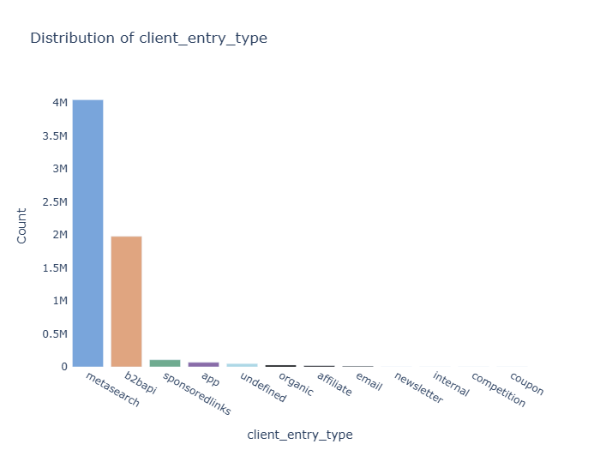
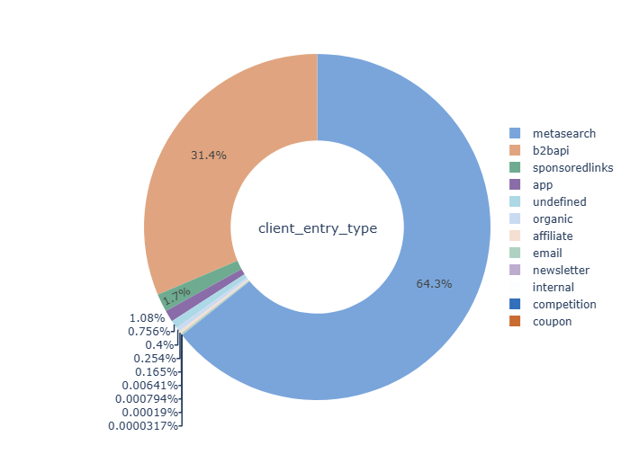
Order Client Entry Type Distribution
Metasearch Dominates: The majority of orders (64.3%) originate from metasearch platforms, highlighting their crucial role in driving customer traffic.
B2B API as a Key Contributor: Business-to-Business APIs account for 31.4% of entries, showing a strong reliance on partner integrations.
Minimal Contribution from Other Channels: Sponsored links, apps, and organic sources collectively contribute a small fraction (under 5%) to the total entries, indicating limited effectiveness compared to metasearch and B2B APIs.
Focus Area: Optimization efforts should target the top two channels (metasearch and B2B API) while exploring strategies to enhance contributions from underutilized channels like organic and affiliate sources.

Slide 15
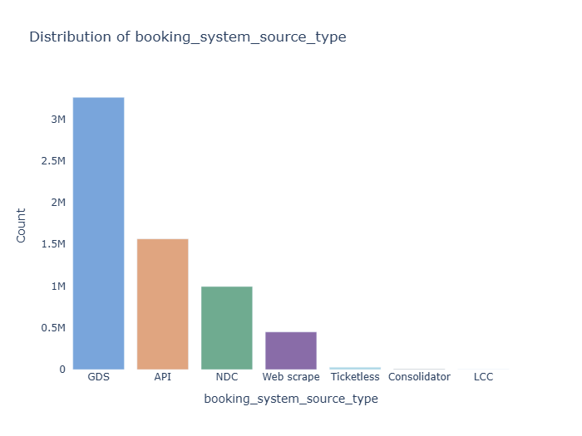
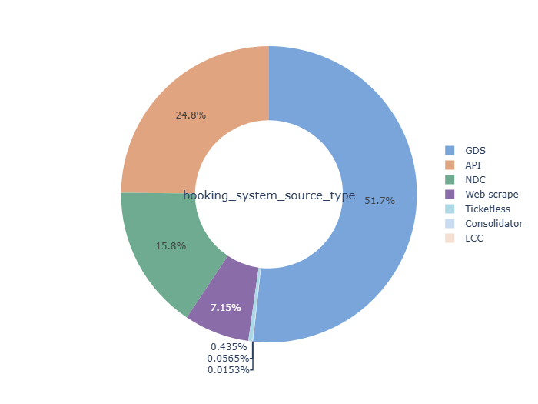
Order Booking System Source Type Distribution
Dominance of GDS: The Global Distribution System (GDS) accounts for over half of the bookings (51.7%), indicating its critical role in the booking system.
Significant API Usage: APIs contribute to 24.8% of bookings, highlighting the importance of seamless integrations for booking management.
Emerging NDC: New Distribution Capability (NDC) has captured 15.8%, reflecting the growing adoption of modern distribution methods.
Minimal Contribution from Other Sources: Web scrape, Ticketless, Consolidator, and LCC collectively account for less than 10%, indicating niche usage or limited reliance on these systems.
These insights demonstrate the importance of focusing on GDS and API optimization while exploring potential growth in NDC and underutilized sources for enhanced efficiency and reach.

Slide 16
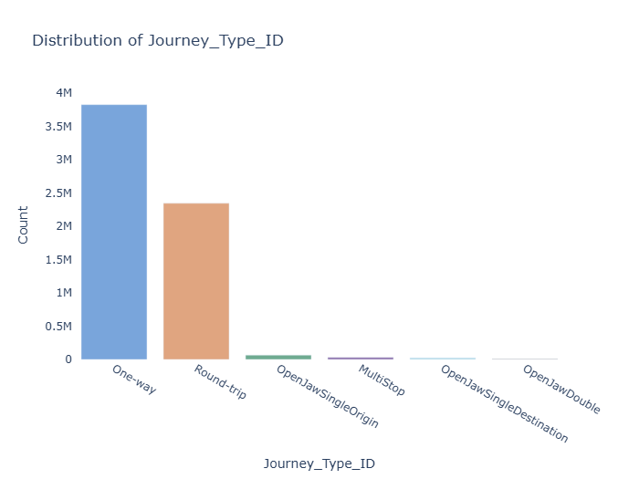
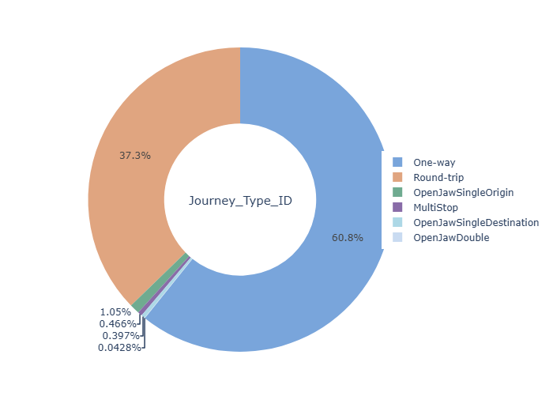
Order Journey Type Distribution
One-Way Dominance: One-way journeys constitute the majority, accounting for 60.8% of all trips, indicating a significant preference for single-destination travel among customers.
Round Trips: Round trips follow, comprising 37.3%, showing a strong customer base for return trips.
Other Journey Types: Less than 2% of the total include multi-stop journeys and open-jaw travel options, reflecting their niche nature in the travel segment.
These insights highlight the dominant preference for simpler journey types and can guide strategies to optimize services for these categories while exploring opportunities to promote less popular journey types.

Slide 17
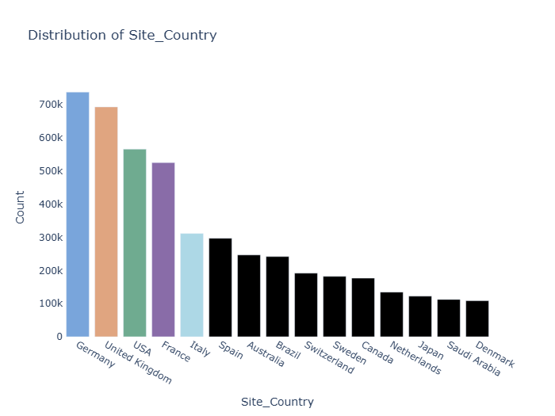
Order Site Country Distribution:
Germany Dominates: Germany has the highest booking count, showcasing it as the top market for orders.
USA and UK Follow: The USA and the UK are significant contributors, ranking closely behind Germany in booking volume.
Western Europe Dominance: Countries like France, Italy, and Spain collectively make Western Europe a prominent region for bookings.
Emerging Markets: Countries like Brazil, Australia, and Canada show moderate activity, reflecting growth opportunities.
Niche Markets: Countries like Japan, Netherlands, and Saudi Arabia contribute smaller volumes but represent untapped potential.
These insights can guide regional marketing strategies, focusing on strengthening the leading markets and exploring opportunities in emerging regions.

Slide 18
Order Currency Distribution:
Euro Dominance: The majority of orders are transacted in Euros, indicating strong activity in European markets.
GBP and USD Follow: The Pound Sterling and US Dollar are the next most common currencies, reflecting the importance of the UK and US markets.
Diverse Currencies: Other currencies, such as the Australian Dollar, Brazilian Real, and Swiss Franc, indicate global operations, although at smaller volumes.
Localized Transactions: The presence of currencies like the Saudi Riyal, South Korean Won, and Japanese Yen highlights regional market penetration.
These insights underline the organization's stronghold in Europe and opportunities for growth in non-European markets.

Slide 19
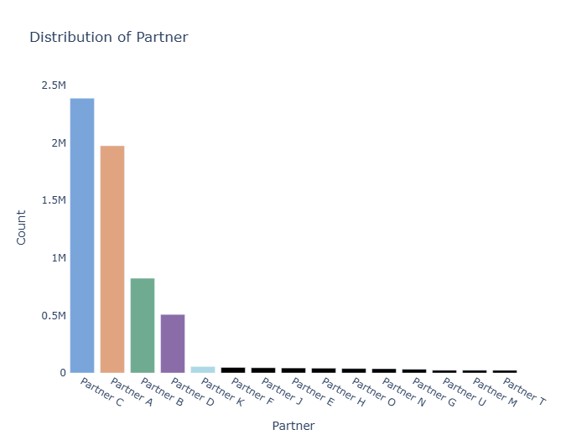
Order Partner Distribution
Top Partners Lead: Partner C and Partner A account for the majority of bookings, highlighting their significant contribution to overall sales.
Secondary Partners: Partner B and Partner D show moderate activity, suggesting their importance as secondary contributors.
Long Tail of Partners: A large number of partners contribute to a small portion of bookings, indicating diversified but less impactful partnerships.
Potential Opportunities: Strengthening relationships with top-performing partners and exploring growth opportunities with underperforming partners could enhance overall performance.
These insights help in identifying key contributors and areas for optimization in partner relationships.

Slide 20
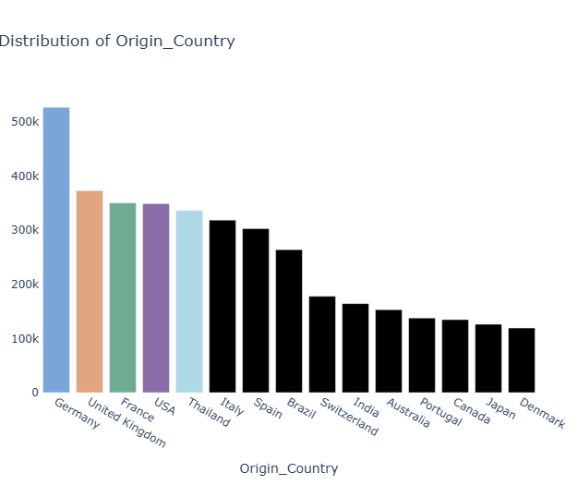
Order Origin Country Distribution
Top Contributor: Germany leads as the most common origin country for journeys, indicating its significance in the travel market.
Prominent Markets: The United Kingdom, USA, and France follow closely, highlighting their strong contributions to travel demand.
Emerging Origins: Countries like Thailand, Brazil, and India show moderate activity, suggesting potential growth opportunities.
Diversified Origins: The distribution indicates a globally diverse customer base, with significant contributions from Europe, North America, and Asia.
These insights highlight key markets and opportunities for targeted marketing and resource allocation.

Slide 21
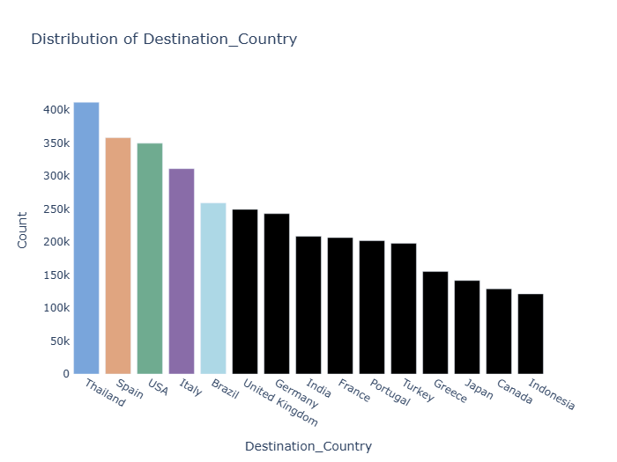
Destination Country Distribution
Top Destination: Thailand emerges as the most popular destination country, indicating strong travel interest toward this region.
Major Preferences: Spain, USA, and Italy are also highly favored destinations, showcasing diverse travel patterns across continents.
Regional Diversity: Brazil, Germany, and India highlight a balance between established and emerging markets.
Travel Hotspots: The data suggests significant traffic to both leisure-focused (e.g., Greece, Turkey) and economic hubs (e.g., USA, Canada).
These insights underline the importance of tailoring offerings to key destination markets and exploring potential in emerging destinations.

Slide 22
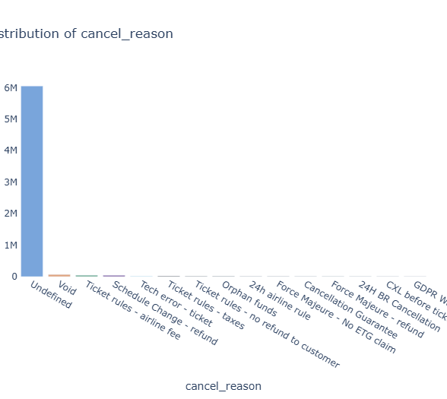
Cancel Reason Distribution
Undefined Category Dominates: The "Undefined" category constitutes the majority of cancellations. There is a clear need for better data recording and categorization to identify actionable insights for reducing cancellations effectively.
Insights into Behavior: Categories like "Schedule Change - refund" or "Ticket rules - refund" indicate specific triggers for cancellations that could guide targeted policy or product adjustments.
Improvement Opportunities: Providing clearer refund policies, flexibility in bookings, and enhanced user communication can reduce cancellations or improve the user experience when cancellations occur.

Slide 23
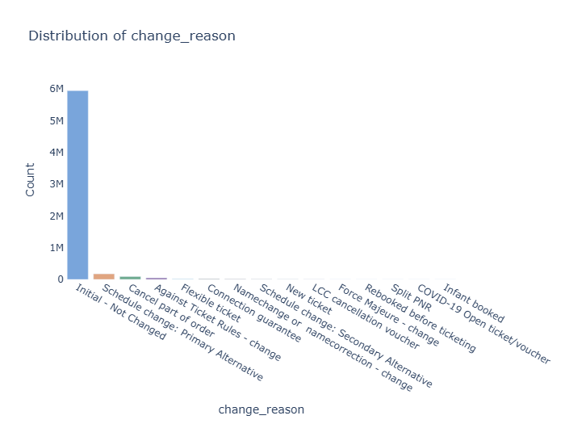
Change Reason Distribution
Dominance of 'Initial - Not Changed': The majority of orders have not undergone any changes, reflecting stable booking patterns for most users.
Minor Reasons for Changes: Among orders with changes, reasons like "Schedule Change," "Flexible Ticket," and "Connection Guarantee" appear prominently, suggesting operational or personal adjustments as common triggers.
Rare Event-Specific Changes: Categories like "COVID-19," "Force Majeure," or "Rebooked PNR" represent minimal occurrences, likely tied to specific scenarios or disruptions.
Opportunity for Process Optimization: By addressing prominent change reasons such as schedule or ticket flexibility, the company can enhance user experience and reduce operational complexities.

Slide 24
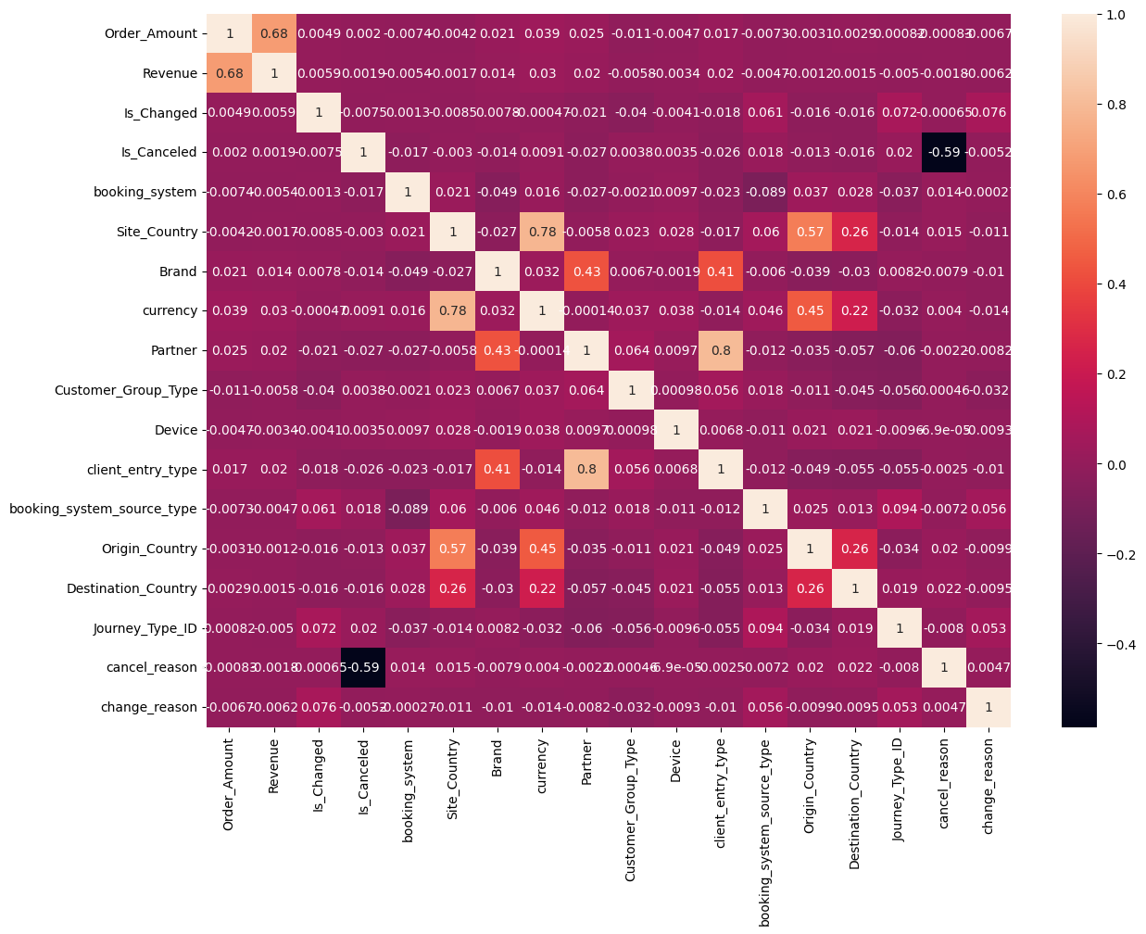
Correlation Analysis of Orders Dataset
Order Amount and Revenue: There is a strong positive correlation (0.68) between Order_Amount and Revenue, indicating that higher order amounts typically contribute to higher revenue. This suggests a direct financial relationship between booking prices and earnings.
Partner and Brand: A moderate positive correlation (0.43) exists between Partner and Brand, implying that specific brands are associated with particular partners in the booking process.
Site Country and Currency : A moderate correlation (0.78) between Site_Country and Currency highlights that bookings are predominantly conducted in the local currency of the booking country.
Journey Type and Order Changes : A weak positive correlation (0.072) between Journey_Type_ID and Is_Changed suggests that certain journey types might be slightly more prone to modifications.
Cancellation and Revenue : A weak negative correlation (-0.59) between Is_Canceled and Revenue underscores the potential revenue impact caused by cancellations.
Client Entry Type and Partner: A moderate correlation (0.41) between client_entry_type and Partner suggests that different client entry types (e.g., metasearch, API) are influenced by the involvement of specific partners.
Key Insights:
Strengthening partnerships with top-performing brands and partners could enhance revenue streams.
Currency and site-country alignment indicate the need for localized payment options.
Efforts to reduce cancellations may significantly preserve revenue.
Enhancing flexibility for journey types prone to changes could improve customer satisfaction.

